Slide 1
EnhancIng Image-Based FashIon AssIstants wIth CondItIoned DIffusIon Models
Project Presentation

Slide 2

Video Introduction

Slide 3
Website tour
Now we will present our website.

Slide 4
Quick Demonstration of Chatbot Interface
We will now quickly demonstrate our chatbot interface that is using our model.

Slide 5
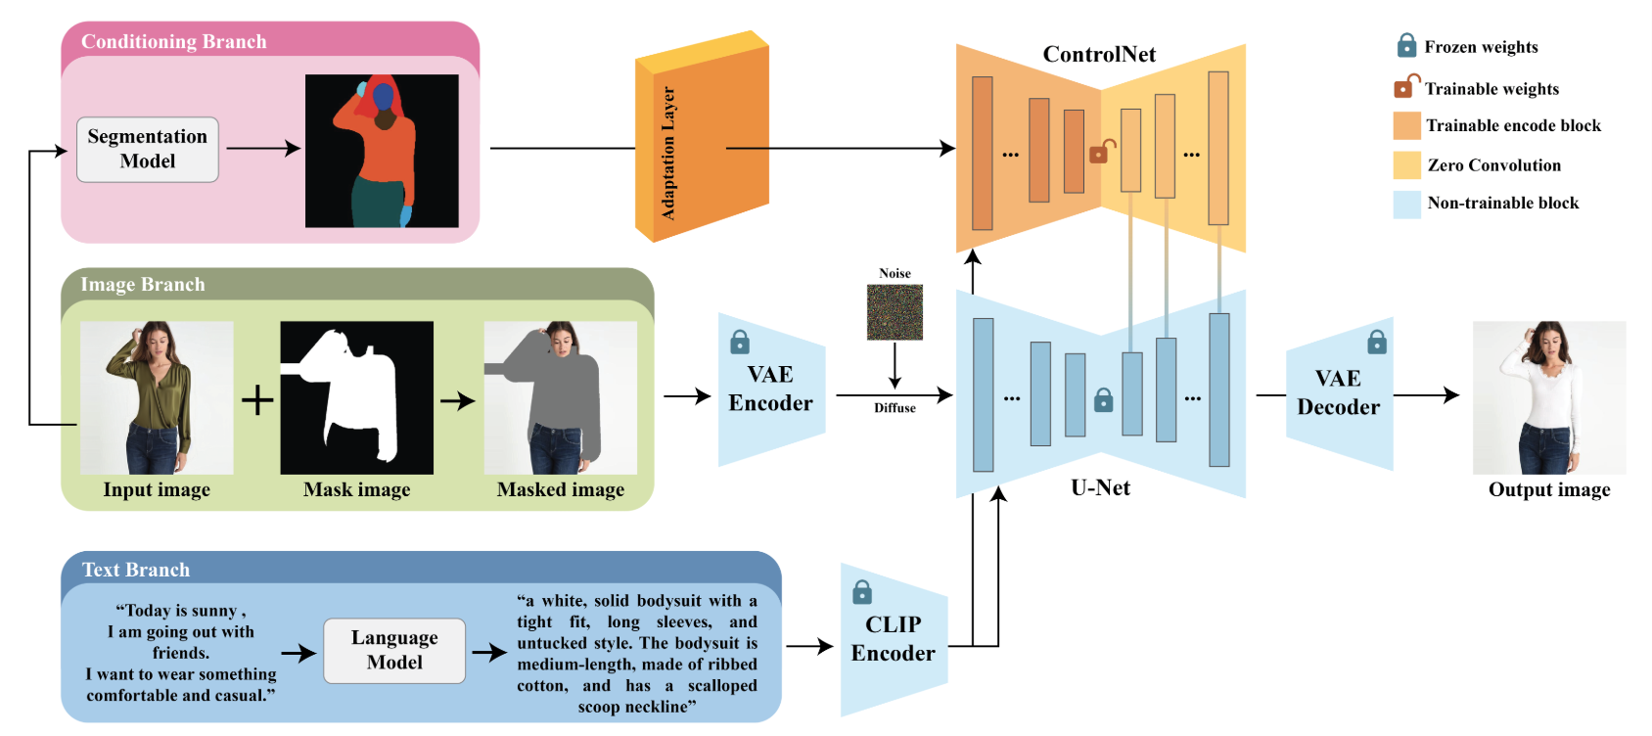
Detailed Workflow
Fine-Tuned ControlNet Inpaint weights using ViTON-HD dataset + ~1000 hand-annotated images

Slide 6
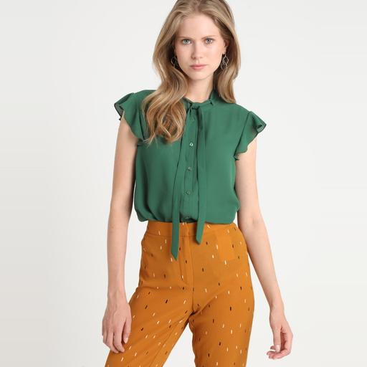
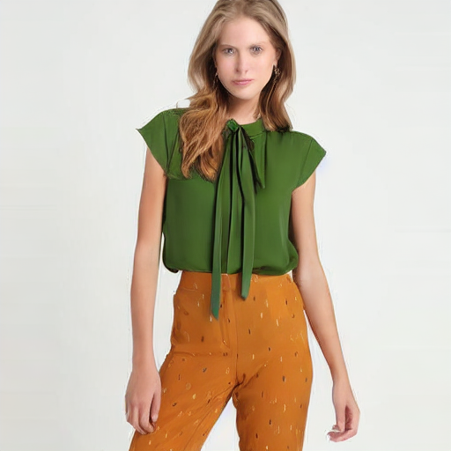
Showcase of Results
Target Image
Model Output

Slide 7
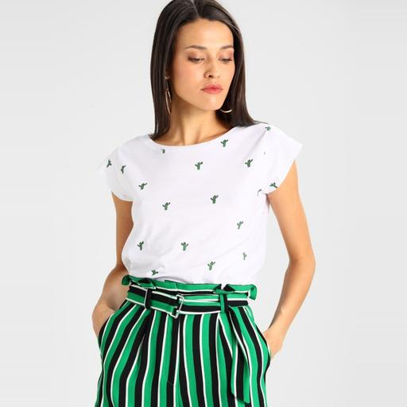
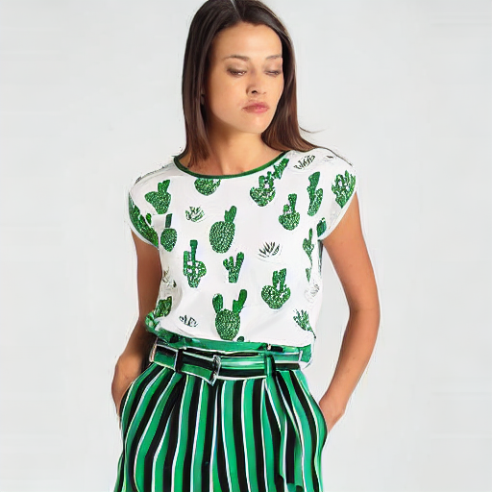
Showcase of Results
Target Image
Model Output

Slide 8
Metric Results
Method | FID_{p}↓ | KID_{p}↓ | PSNR_{p}↑ | SSIM_{p}↑ | LPIPS_{p}↓
PF-AFN | 6.554 | 0.81 | 23.54 | 0.888 | 0.087
FS-VTON | 6.170 | 0.69 | 23.79 | 0.886 | 0.074
HR-VTON | 11.383 | 3.52 | 21.61 | 0.865 | 0.122
SDAFN | 6.605 | 0.83 | 23.24 | 0.880 | 0.082
GP-VTON | 6.031 | 0.60 | 23.41 | 0.885 | 0.080
LADI-VTON | 6.602 | 1.09 | 22.49 | 0.866 | 0.094
DCI-VTON | 5.521 | 0.41 | 24.01 | 0.882 | 0.080
SD-VTON | 6.986 | 1.00 | 22.73 | 0.874 | 0.101
D4-VTON | 4.845 | 0.04 | 24.71 | 0.892 | 0.065
Ours | 14.2044 | 0.4 | 18.49 | 0.843 | 0.073

Slide 9
Discussion
We propose a method that produces a succesful solution for visual try-on methods that conditions the text-to-image model to guide the model better to create a realistic output.
Our model achieved the second-best score for two metrics across other models with the same goal. We consider this project a success for the scale of our group and the resources we had.
Thank you for listening and we can answer any questions you might have!

